Slide 1

ROCKBUSTER STEALTH
DATABASE ANALYSIS
REBECCAH AJULO

Slide 2
Rockbuster Stealth LLC is a movie rental company that used to have stores around the world. Facing stiff competition from streaming services such as Netflix and Amazon Prime, the Rockbuster Stealth management team is planning to use its existing movie licenses to launch an online video rental service in order to stay competitive.
Project Brief

Slide 3

Key Questions
● Which movies contributed the most/least to revenue gain?
● What was the average rental duration for all videos?
● Which countries are Rockbuster customers based in?
● Where are customers with a high lifetime value based?
● Do sales figures vary between geographic regions?

Slide 4
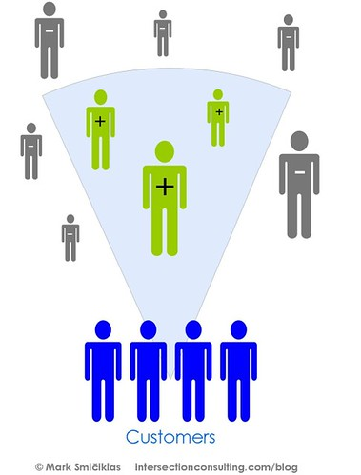






Rockbuster Analysis Overview
Number of Movies
1000
Average Rental Duration
5 Days
Number of Customers
599
Rental Duration
3 →7 Days
Average Rental Rate
2.98
Length of Movie
46 mins → 185 mins
Mode (Rating)
PG-13
Replacement Cost
9.99 → 29.99

Slide 5
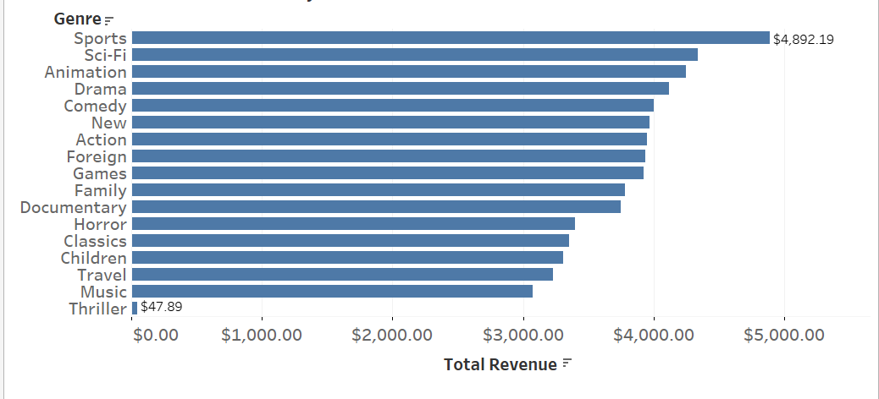
Total Revenue by Genre
Revenue Analysis
SPORTS movies have the highest total revenue
THRILLER movies have the least total revenue

Slide 6
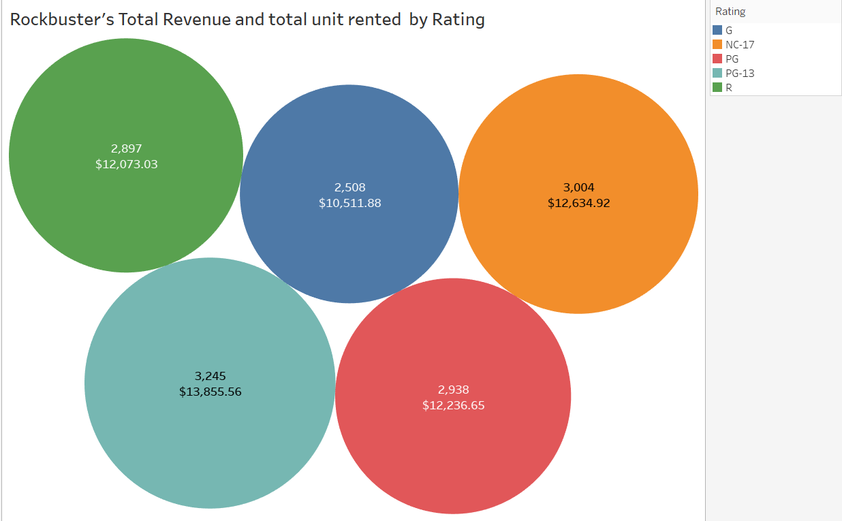
Total Revenue and Total rented units by Rating
Revenue Analysis
PG-13 has the highest total Revenue and unit rented
G has the least Revenue and unit rented

Slide 7
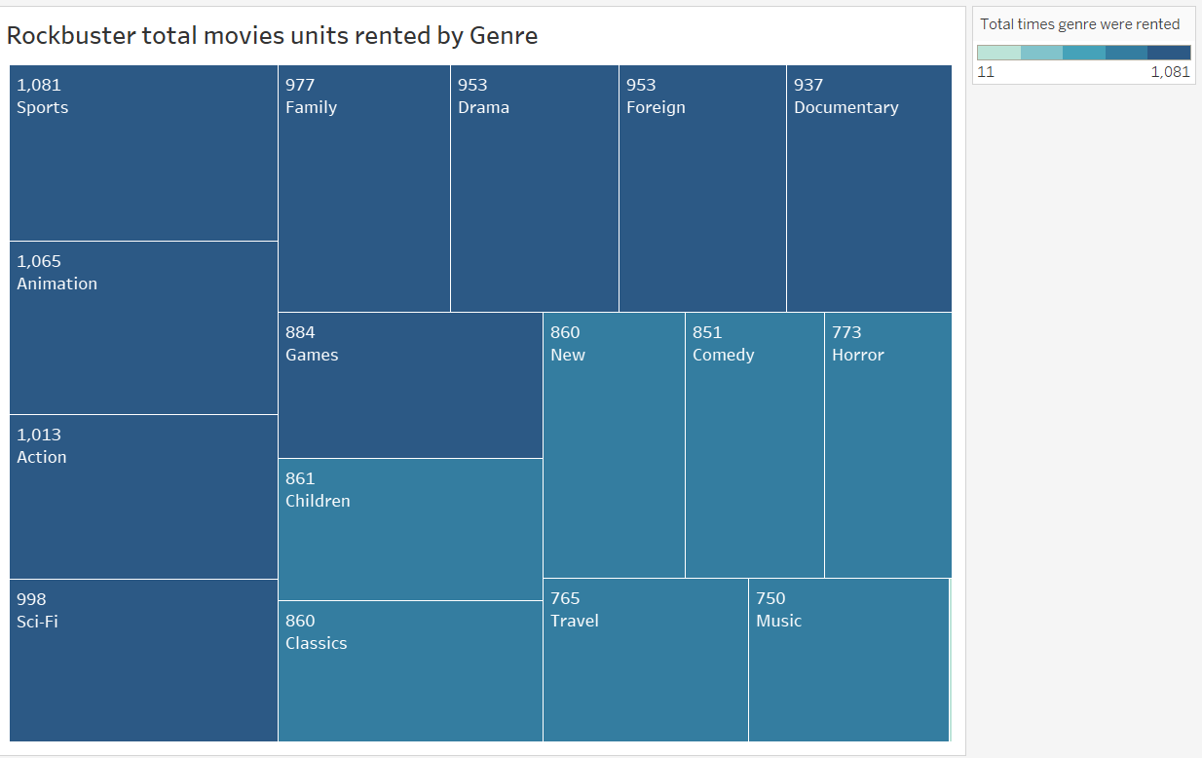
Total movies units rented by genre
Revenue Analysis

Slide 8
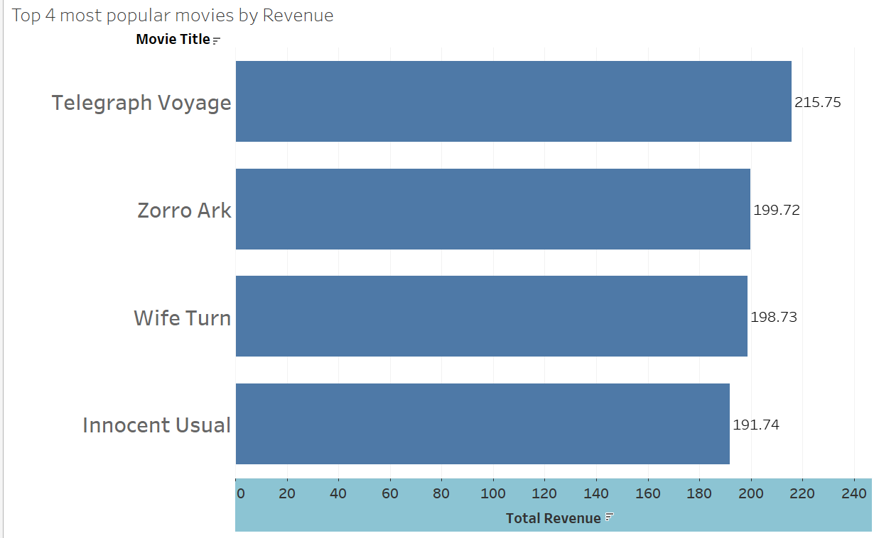
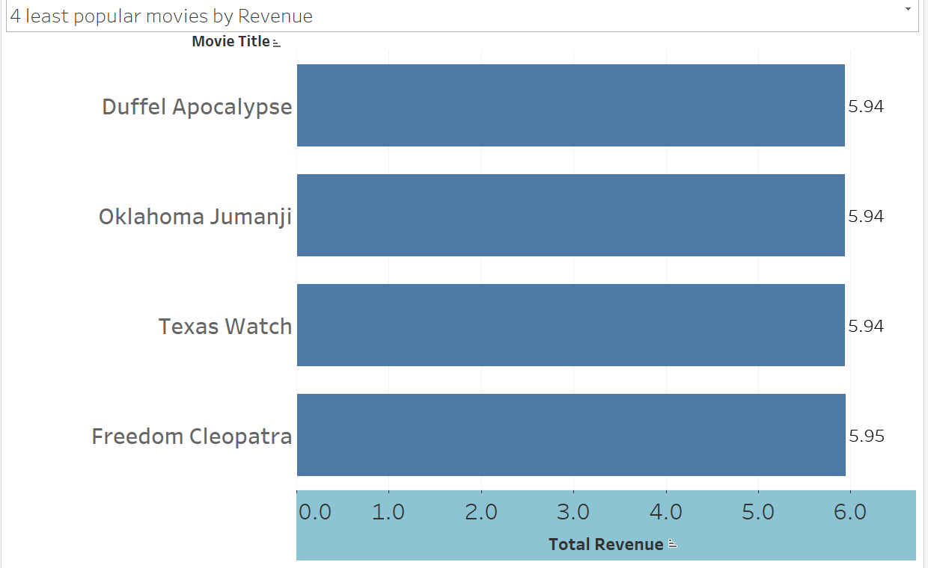
Most/least most popular movies by Revenue
Revenue Analysis
4 Least popular movies
Top 4 most popular movies

Slide 9
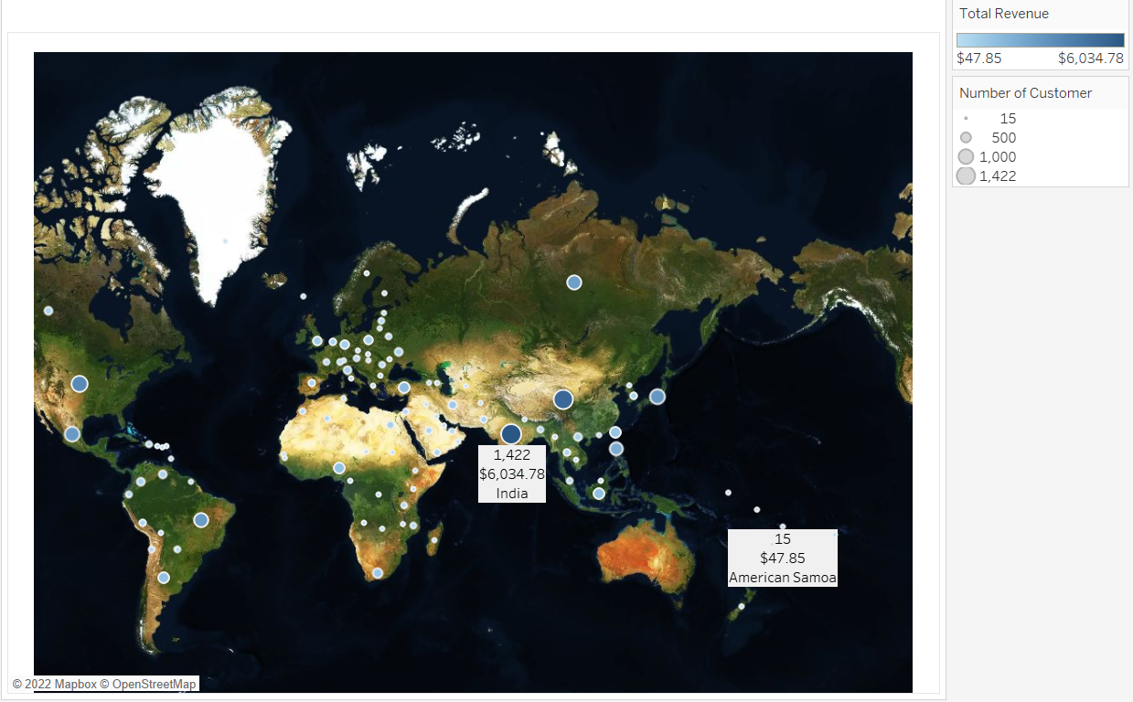
Rockbuster’s current geographical distribution of customers and revenue generated in each country.
GEOGRAPHICAL ANALYSIS
Rockbuster”s Customers are based in 108 countries with the highest in India which also has the highest revenue followed by China, the United state, Japan and Mexico.
The least is American Samoa.

Slide 10
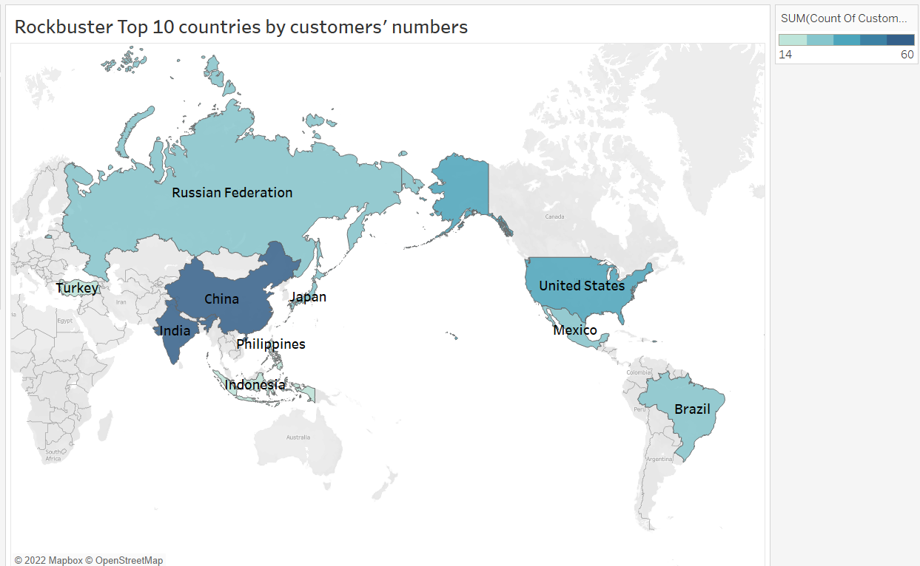
TOP 10 COUNTRIES BY CUSTOMERS NUMBER
GEOGRAPHICAL ANALYSIS
Country | Customers | Revenue
India | 1422 | 6034.78
China | 1297 | 5251.03
United States | 869 | 3685.31
Japan | 749 | 3122.51
Mexico | 718 | 2984.82
Brazil | 681 | 2919.19
Russian Federation | 638 | 2765.62
Philippines | 530 | 2219.7
Turkey | 351 | 1498.49
Indonesia | 331 | 1352.69

Slide 11
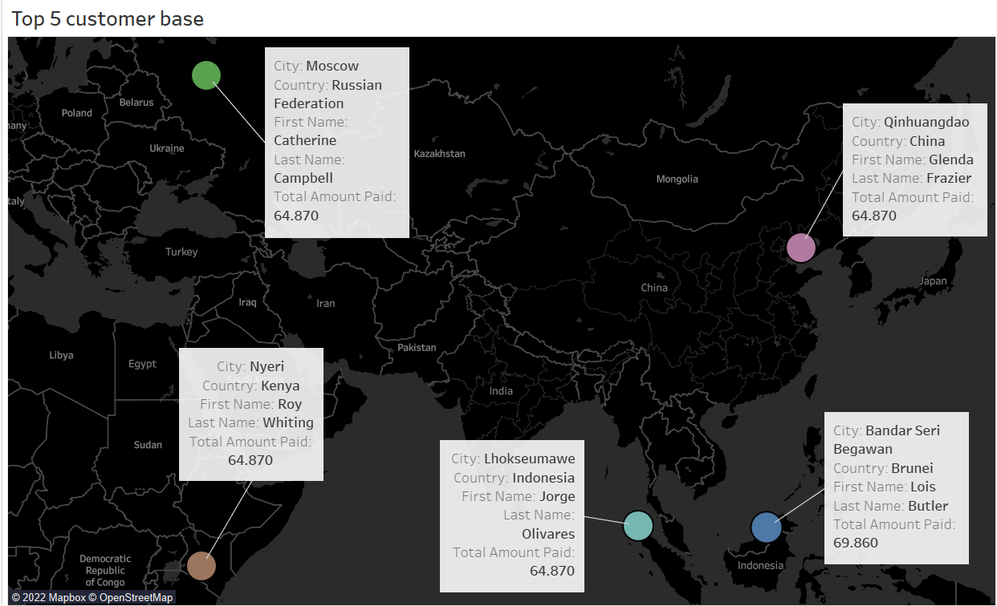
Top 5 customers, their location and amount spent

Slide 12
suggestion
● Focus on top-selling genres for each country.
●create loyalty rewards for returning customers.
● Create more campaigns to increase popularity and increase revenue
● Make available popular genres and ratings

Slide 13



THANK YOU! Presented by Rebeccah Ajulo Tableau link

